Slide 1
UNIT–I
Data Warehousing and Online Analytical Processing: Basic concepts, Data Warehouse Modelling: Data Cube and OLAP, Data Warehouse Design and Usage, Data Warehouse Implementation, Cloud Data Warehouse.
Data Mining and Patten Mining, Technologies, Applications, Major issues.
Data Objects &Attribute Types, Basic Statistical Descriptions of Data, Data Visualization, Measuring Data Similarity and Dissimilarity.

Slide 2
“Data Mining also known as knowledge discovery from data or KDD”
What is Data Mining?
Many Definitions..
- Non-trivial extraction of implicit, previously unknown and potentially useful information from data.
- Exploration & analysis, by automatic or semi-automatic means, of large quantities of data in order to discover meaningful patterns.

Slide 3
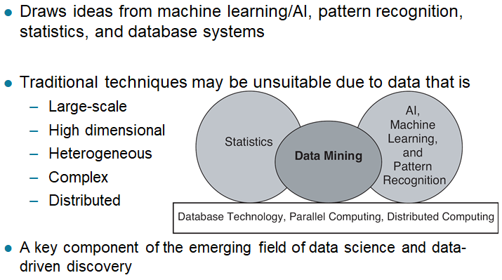
Origins of Data Mining:

Slide 4
Data Mining Tasks:
Prediction Methods:
Use some variables to predict unknown or future values of other variables.
Description Methods:
Find human-interpretable patterns that describe the data.

Slide 5
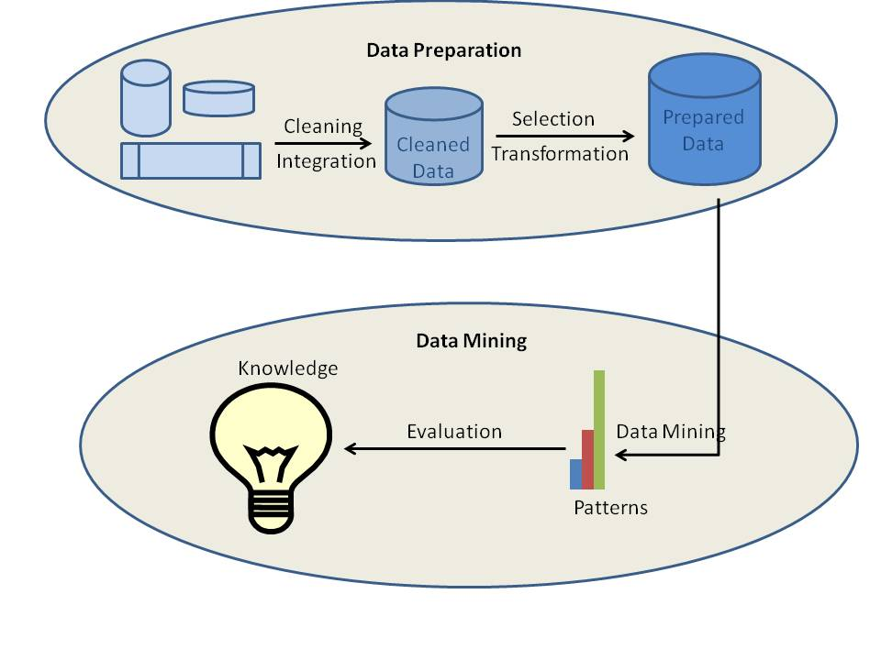
Data Mining Processes

Slide 6
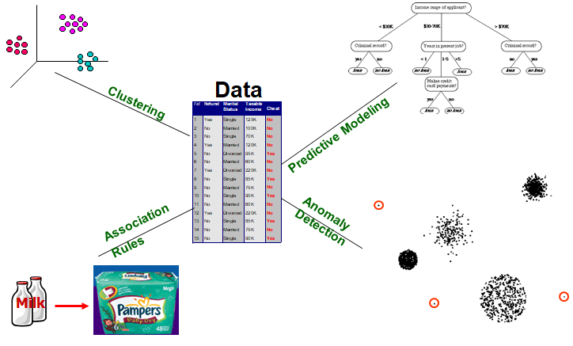
Data Mining Tasks …

Slide 7
Data Mining as the Evolution of Information Technology:
Data mining can be viewed as a result of the natural evolution of information technology. The database and data management industry evolved in the development of several critical functionalities (Figure 1.1): data collection and database creation, data management, and advanced data analysis.

Slide 8
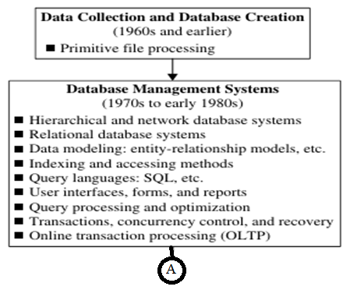

Slide 9
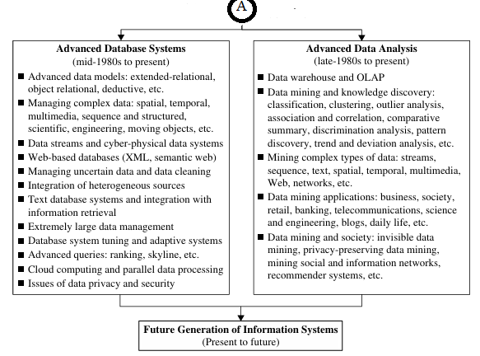

Slide 10
One emerging data repository architecture is the data warehouse. This is a repository of multiple heterogeneous data sources organized under a unified schema at a single site to facilitate management decision making. Data warehouse technology includes data cleaning, data integration, and online analytical processing (OLAP) - that is, analysis techniques with functionalities such as summarization, consolidation, and aggregation, as well as the ability to view information from different angles. Although OLAP tools support multidimensional analysis and decision making, additional data analysis tools are required for in-depth analysis.
for example: Data Mining tools that provide data classification, clustering, outlier/anomaly detection, and the characterization of changes in data over time.
Huge volumes of data have been accumulated beyond databases and data ware houses. During the 1990s, the World Wide Web and web-based databases (e.g., XML databases) began to appear.

Slide 11
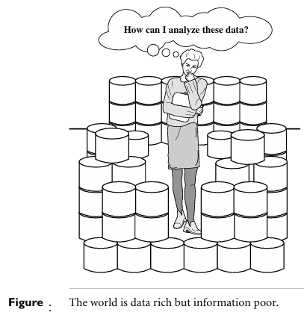
Internet-based global information bases, such as the WWW and various kinds of interconnected, heterogeneous databases, have emerged and play a vital role in the information industry. The effective and efficient analysis of data from such different forms of data by integration of information retrieval, data mining, and information network analysis technologies is a challenging task.

Slide 12
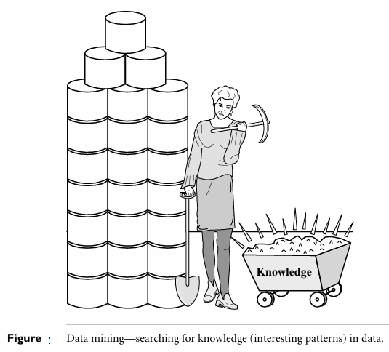
What is Data Mining?

Slide 13
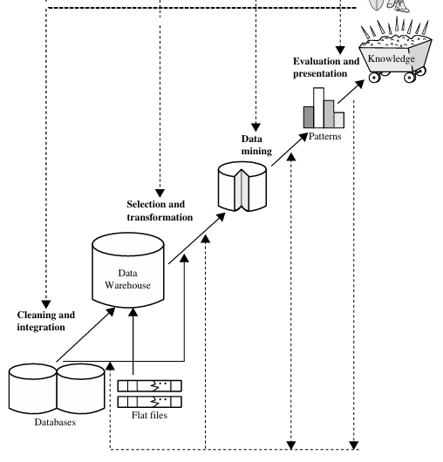

Slide 14
The knowledge discovery process is shown in above Fig. as an iterative sequence of the following steps:
1. Data cleaning (to remove noise and inconsistent data)
2. Data integration (where multiple data sources may be combined)
3. Data selection (where data relevant to the analysis task are retrieved from the database)
4. Data transformation (where data are transformed and consolidated into forms appropriate for mining by performing summary or aggregation operations)
5. Data mining (an essential process where intelligent methods are applied to extract data patterns)
6. Pattern evaluation (to identify the truly interesting patterns representing knowledge based on interestingness measures)
7. Knowledge presentation (where visualization and knowledge representation techniques are used to present mined knowledge to users)

Slide 15
What Kinds of Data Can Be Mined?
The most basic forms of data for mining applications are database data, data warehouse data, and transactional data.
Database Data:
A database system, also called a database management system (DBMS), consists of a collection of interrelated data, known as a database, and a set of software programs to manage and access the data.
A relational database is a collection of tables, each of which is assigned a unique name. Each table consists of a set of attributes (columns or fields) and usually stores a large set of tuples (records or rows). Each tuple in a relational table represents an object identified by a unique key and described by a set of attribute values. A semantic data model, such as an entity-relationship (ER) data model, is often constructed for relational databases.

Slide 16
Data Warehouses:
Suppose that AllElectronics is a successful international company with branches around the world. Each branch has its own set of databases. The president of AllElectronics has asked you to provide an analysis of the company’s sales per item type per branch for the third quarter. This is a difficult task, particularly since the relevant data are spread out over several databases physically located at numerous sites. If AllElectronics had a data warehouse, this task would be easy.
A data warehouse is a repository of information collected from multiple sources, stored under a unified schema, and usually residing at a single site. Data warehouses are constructed via a process of data cleaning, data integration, data transformation, data loading, and periodic data refreshing.
To facilitate decision making, the data in a data warehouse are organized around major subjects (e.g., customer, item, supplier, and activity). The data are stored to pro vide information from a historical perspective, such as in the past 6 to 12 months, and are typically summarized. For example, rather than storing the details of each sales transaction, the data warehouse may store a summary of the transactions per item type for each store or, summarized to a higher level, for each sales region.

Slide 17
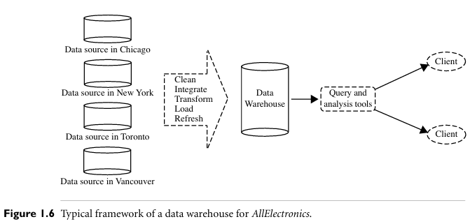
A data warehouse is usually modeled by a multidimensional data structure, called a data cube, in which each dimension corresponds to an attribute or a set of attributes in the schema, and each cell stores the value of some aggregate measure such as count or sum (sales amount). A data cube provides a multidimensional view of data and allows the precomputation and fast access of summarized data.

Slide 18
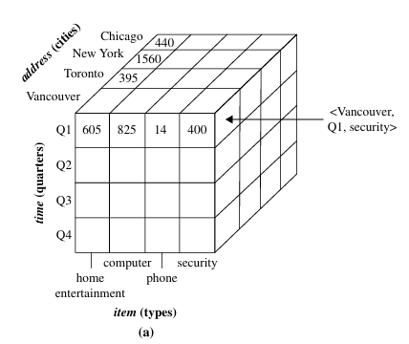

Slide 19
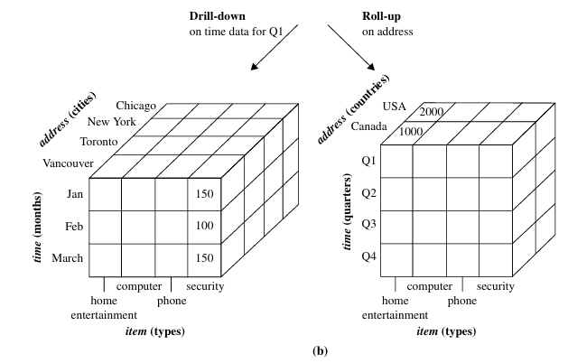
Figure 1.7 A multidimensional data cube, commonly used for data warehousing, (a) showing summarized data for AllElectronics and (b) showing summarized data resulting from drill-down and roll-up operations on the cube in (a). For improved readability, only some of the cube cell values are shown.

Slide 20
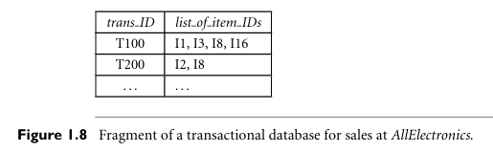
Transactional Data
In general, each record in a transactional database captures a transaction, such as a customer’s purchase, a flight booking, or a user’s clicks on a web page. A transaction typically includes a unique transaction identity number (trans ID) and a list of the items making up the transaction, such as the items purchased in the transaction.
A transactional database for AllElectronics. Transactions can be stored in a table, with one record per transaction. A fragment of a transactional database for AllElectronics is shown in Figure 1.8.

Slide 21
Other Kinds of Data:
Besides relational database data, data warehouse data, and transaction data, there are many other kinds of data that have versatile forms and structures and rather different semantic meanings. Such kinds of data can be seen in many applications: time-related or sequence data (e.g., historical records, stock exchange data, and time-series and bio logical sequence data), data streams (e.g., video surveillance and sensor data, which are continuously transmitted), spatial data (e.g., maps), engineering design data (e.g., the design of buildings, system components, or integrated circuits).

Slide 22
Kinds of Patterns Can Be Mined
There are a number of data mining functionalities. These include
Characterization and discrimination;
The mining of frequent patterns, associations, and correlations;
Classification and regression;
Clustering analysis; and
Outlier analysis.
Data mining functionalities are used to specify the kinds of patterns to be found in data mining tasks. Such tasks can be classified into two categories: descriptive and predictive.
Descriptive mining tasks characterize properties of the data in a target data set.
Predictive mining tasks perform induction on the current data in order to make predictions.

Slide 23
Class/Concept Description: Characterization and Discrimination
Describe the individual classes and concepts in summarized and concise way is called descriptions of a class or a concept.
These descriptions can be derived using :
Data characterization, by summarizing the data of the class, or
Data discrimination, by comparison of the target class with one or a set of comparative classes, or
Both data characterization and discrimination.
Ex: Data characterization. A customer relationship manager at AllElectronics may order the following data mining task: Summarize the characteristics of customers who spend more than $5000 a year at AllElectronics. The result is a general profile of these customers, such as that they are 40 to 50 years old, employed, and have excellent credit ratings. The data mining system should allow the customer relationship manager to drill down on any dimension, such as on occupation to view these customers according to their type of employment.

Slide 24
Ex-2: Data discrimination. A customer relationship manager at AllElectronics may want to compare two groups of customers—those who shop for computer products regularly (e.g., more than twice a month) and those who rarely shop for such products (e.g., less than three times a year). The resulting description provides a general comparative profile of these customers, such as that 80% of the customers who frequently purchase computer products are between 20 and 40 years old and have a university education, whereas 60% of the customers who infrequently buy such products are either seniors or youths, and have no university degree. Drilling down on a dimension like occupation, or adding a new dimension like income level, may help to find even more discriminative features between the two classes

Slide 25
Mining Frequent Patterns, Associations, and Correlations:
There are many kinds of frequent patterns, including frequent itemsets, frequent sub sequences and frequent substructures.
A frequent itemset typically refers to a set of items that often appear together in a transactional data set—for example, milk and bread, which are frequently bought together in grocery stores by many customers.
A frequently occurring subsequence, such as the pattern that customers, tend to purchase first a laptop, followed by a digital camera, and then a memory card, is a (frequent) sequential pattern.
A substructure can refer to different structural forms (e.g., graphs, trees, or lattices) that may be combined with itemsets or subsequences. If a substructure occurs frequently, it is called a (frequent) structured pattern.
Mining frequent patterns leads to the discovery of interesting associations and correlations within data.

Slide 26

Ex: Suppose that, as a marketing manager at AllElectronics, you want to know which items are frequently purchased together (i.e., within the same transaction). An example of such a rule, mined from the AllElectronics transactional database, is:
where X is a variable representing a customer. A confidence, or certainty, of 50% means that if a customer buys a computer, there is a 50% chance that she will buy software as well. A 1% support means that 1% of all the transactions under analysis show that computer and software are purchased together. This association rule involves a single attribute or predicate (i.e., buys) that repeats.
The rule indicates that of the AllElectronics customers under study, 2% are 20 to 29 years old with an income of $40,000 to $49,000 and have purchased a laptop (computer) at AllElectronics.

Slide 27
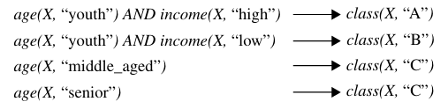
Classification and Regression for Predictive Analysis Classification is the process of finding a model (or function) that describes and distinguishes data classes or concepts. The model are derived based on the analysis of a set of training data (i.e., data objects for which the class labels are known).
The model is used to predict the class label of objects for which the class label is unknown.
“How is the derived model presented?” The derived model may be represented in various forms, such as classification rules (i.e., IF-THEN rules), decision trees, mathematical formulae, or neural networks. A decision tree is a flow chart – like tree structure, where each node denotes a test on an attribute value, each branch represents an outcome of the test, and tree leaves represent classes or class distributions. Decision trees can easily be converted to classification rules.

Slide 28
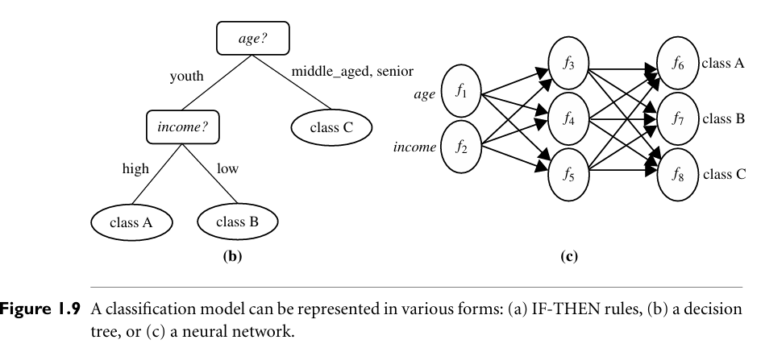

Slide 29
Ex: Sales manager of AllElectronics want to classify a large set of items in the store, based on three kinds of responses to a sales campaign: good response, mild response and no response.
To derive a model for each of these three classes based on the descriptive features of the items, such as price, brand, place made, type, and category.
Cluster Analysis:
Unlike classification and regression, which analyze class-labeled (training) data sets, clustering analyzes data objects without consulting class labels. The objects are clustered or grouped based on the principle of maximizing the intra class similarity and minimizing the interclass similarity.

Slide 30
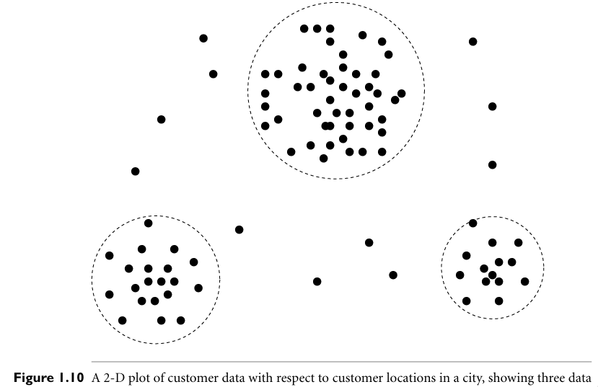

Slide 31
Outlier Analysis:
A data set may contain objects that do not comply with the general behavior or model of the data. These data objects are outliers. Many data mining methods discard outliers as noise or exceptions.
In some applications (e.g., fraud detection) the rare events can be more interesting than the more regularly occurring ones. The analysis of outlier data is referred to as outlier analysis or anomaly mining.
Ex: Outlier analysis may uncover fraudulent usage of credit cards by detecting purchases of unusually large amounts for a given account number in comparison to regular charges incurred by the same account. Outlier values may also be detected with respect to the locations and types of purchase, or the purchase frequency.

Slide 32

Support:
Support measures how frequently an itemset appears in the dataset.
Mathematically:
Example:
Suppose we have 1,000 transactions in a supermarket.
The itemset {Milk, Bread} appears in 100 transactions.
Then,
Support({Milk, Bread})= 100 / 1000 = 0.1 = 10%
So, 10% of all transactions contain both milk and bread.

Slide 33

Confidence:
Confidence measures how often items in Y appear in transactions that contain X. It shows the likelihood of Y being purchased when X is purchased.
Mathematically:
It’s the conditional probability of Y given X.
Example:
Again, out of 1,000 transactions:
{Milk} appears in 200 transactions.
{Milk, Bread} appears in 100 transactions.
Then,
Confidence({Milk}⇒{Bread})= 100 / 200 = 0.5 = 50%
This means that 50% of the transactions that contain milk also contain bread.

Slide 34
Transaction ID | Items Purchased
T1 | Milk, Bread, Butter
T2 | Beer, Diapers, Bread, Milk
T3 | Milk, Diapers, Bread, Butter
T4 | Bread, Butter
T5 | Beer, Bread
Rule: {Milk} ⇒ {Bread}
Total transactions = 5
Transactions containing {Milk} = T1, T2, T3 → 3
Transactions containing {Milk, Bread} = T1, T2, T3 → 3
So,
Support({Milk, Bread})=3/5=60%
Confidence({Milk}⇒{Bread})=3/3=100%
This means:
60% of transactions include both Milk and Bread.
If a customer buys Milk, there’s a 100% chance they also buy Bread.

Slide 35
Predictive Modeling: Classification:
Find a model for class attribute as a function of the values of other attributes
Model for predicting credit worthiness
Class

Slide 36
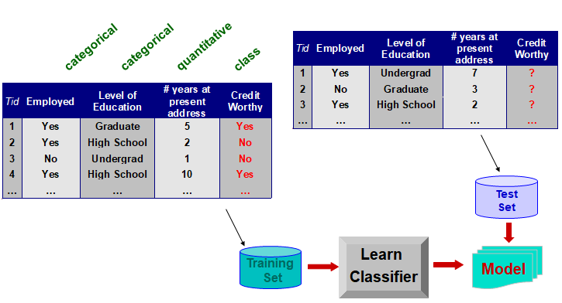
Classification Example

Slide 37
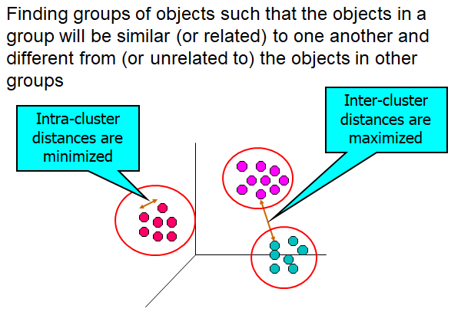
Clustering:

Slide 38
Are All Patterns Interesting?
A data mining system has the potential to generate thousands or even millions of patterns, or rules. Typically, all of the patterns are not interesting and only a small fraction of the patterns potentially generated would actually be of interest to a given user.
This raises some serious questions for data mining.
What makes a pattern interesting?
Can a data mining system generate all of the interesting patterns? Or,
Can the system generate only the interesting ones?
To answer the first question, a pattern is interesting if it is
easily understood by humans,
Valid on new or test data with some degree of certainty,
Potentially useful, and
Novel.
A pattern is also interesting if it validates a hypothesis that the user sought to confirm. An interesting pattern represents knowledge.

Slide 39
To answer the second question:
Refers to the completeness of a data mining algorithm. It is often unrealistic and inefficient for data mining systems to generate all possible patterns. Instead, user provided constraints and interestingness measures should be used to focus the search. For some mining tasks, such as association, this is often sufficient to ensure the completeness of the algorithm. Association rule mining is an example where the use of constraints and interestingness measures can ensure the completeness of mining.
Finally, the third question:
It is an optimization problem in data mining. It is highly desirable for data mining systems to generate only interesting patterns. This would be efficient for users and data mining systems because neither would have to search through the patterns generated to identify the truly interesting ones. Progress has been made in this direction; however, such optimization remains a challenging issue in data mining.

Slide 40
Technologies Used
Data mining has incorporated many techniques from other domains such as statistics, machine learning, pattern recognition, database and data warehouse systems, information retrieval, visualization, algorithms, high performance computing, and many application domains.
Statistics:
Statistics studies the collection, analysis, interpretation or explanation, and presentation of data. Data mining has an inherent connection with statistics.
A statistical model is a set of mathematical functions that describe the behavior of the objects in a target class in terms of random variables and their associated probability distributions. These are widely used to model data and data classes.
For example, in data mining tasks like data characterization and classification, statistical models of target classes can be built.

Slide 41
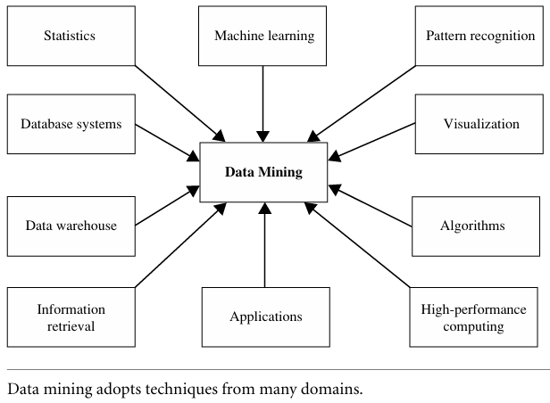

Slide 42
Machine Learning
Machine learning investigates how computers can learn (or improve their performance) based on data. A main research area is for computer programs to automatically learn to recognize complex patterns and make intelligent decisions based on data.
For example, a typical machine learning problem is to program a computer so that it can automatically recognize handwritten postal codes on mail after learning from a set of examples.
Supervised learning: The supervision in the learning comes from the labeled examples in the training data set.
Unsupervised learning is essentially a synonym for clustering. The learning process is unsupervised since the input examples are not class labeled. Typically, we may use clustering to discover classes within the data. For example, an unsupervised learning method can take, as input, a set of images of handwritten digits. Suppose that it finds 10 clusters of data. These clusters may correspond to the 10 distinct digits of 0 to 9, respectively. However, since the training data are not labeled, the learned model cannot tell us the semantic meaning of the clusters found.

Slide 43
Semi-supervised learning:
It is a class of machine learning techniques that make use of both labeled and unlabeled examples when learning a model. In one approach, labeled examples are used to learn class models and unlabeled examples are used to refine the boundaries between classes. For a two-class problem, we can think of the set of examples belonging to one class as the positive examples and those belonging to the other class as the negative examples.
In following Fig. if we do not consider the unlabeled examples, the dashed line is the decision boundary that best partitions the positive examples from the negative examples. Using the unlabeled examples, we can refine the decision boundary to the solid line. Moreover, we can detect that the two positive examples at the top right corner, though labeled, are likely noise or outliers.

Slide 44
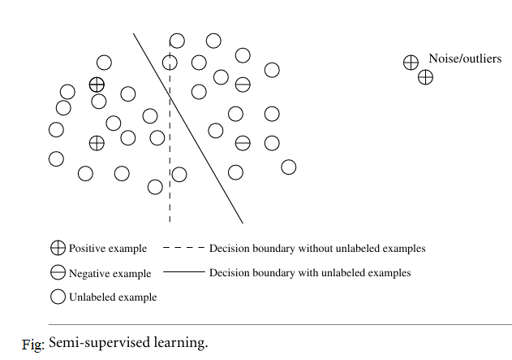

Slide 45
Database Systems and Data Warehouses:
Database systems research focuses on the creation, maintenance, and use of databases for organizations and end-users. Particularly, database systems researchers have established highly recognized principles in data models, query languages, query processing and optimization methods, data storage, and indexing and accessing methods.
Many data mining tasks need to handle large data sets or even real-time, fast streaming data. Therefore, data mining can make good use of scalable database technologies to achieve high efficiency and scalability on large data sets.
A data warehouse integrates data originating from multiple sources and various timeframes. It consolidates data in multidimensional space to form partially materialized data cubes. The data cube model not only facilitates OLAP in multidimensional databases but also promotes multidimensional data mining.

Slide 46
Information Retrieval
Information retrieval (IR) is the science of searching for documents or information in documents. Documents can be text or multimedia, and may reside on the Web. The differences between traditional information retrieval and database systems are two fold: Information retrieval assumes that
The data under search are unstructured; and
The queries are formed mainly by keywords, which do not have complex structures.
The typical approaches in information retrieval adopt probabilistic models. For example, a text document can be regarded as a bag of words, that is, a multi set of words appearing in the document. The document’s language model is the probability density function that generates the bag of words in the document.
Increasingly large amounts of text and multimedia data have been accumulated and made available online due to the fast growth of the Web and applications such as digital libraries, digital governments, and health care information systems. Their effective search and analysis have raised many challenging issues in data mining. Therefore, text mining and multimedia data mining, integrated with information retrieval methods, have become increasingly important.

Slide 47
Applications:
As a highly application-driven discipline, data mining has seen great successes in many applications.
Two highly successful and popular application examples of data mining: Business Intelligence and Search Engines.
Business Intelligence:
It is critical for businesses to acquire a better understanding of the commercial context of their organization, such as their customers, the market, supply and resources, and competitors. Business intelligence (BI) technologies provide historical, current, and predictive views of business operations.
Ex: reporting, online analytical processing, business performance management, competitive intelligence, benchmarking, and predictive analytics.
Importance: Without data mining, many businesses may not be able to perform effective market analysis, compare customer feedback on similar products, discover the strengths and weaknesses of their competitors, retain highly valuable customers, and make smart business decisions.

Slide 48
Web Search Engines:
A Web search engine is a specialized computer server that searches for information on the Web. The search results of a user query are often returned as a list (sometimes called hits). The hits may consist of web pages, images, and other types of files. Some search engines also search and return data available in public databases or open directories. Search engines differ from web directories in that web directories are maintained by human editors whereas search engines operate algorithmically or by a mixture of algorithmic and human input.
Web search engines are essentially very large data mining applications. Various data mining techniques are used in all aspects of search engines, ranging from crawling (e.g., deciding which pages should be crawled and the crawling frequencies), indexing (e.g., selecting pages to be indexed and deciding to which extent the index should be constructed), and searching (e.g., deciding how pages should be ranked, which advertisements should be added, and how the search results can be personalized or made “context aware”).

Slide 49
Search engines pose grand challenges to data mining:
They have to handle a huge and ever-growing amount of data.
Web search engines often have to deal with online data.
Web search engines often have to deal with queries that are asked only a very small number of times.
Major Issues in Data Mining:
Mining Methodology:
Researchers have been vigorously developing new data mining methodologies. This involves the investigation of new kinds of knowledge, mining in multidimensional space, integrating methods from other disciplines, and the consideration of semantic ties among data objects. In addition, mining methodologies should consider issues such as data uncertainty, noise, and incompleteness.

Slide 50
Various aspects of mining methodology are:
Mining various and new kinds of knowledge: Data mining covers a wide spectrum of data analysis and knowledge discovery tasks, from data characterization and discrimination to association and correlation analysis, classification, regression, clustering, outlier analysis, sequence analysis, and trend and evolution analysis.
Mining knowledge in multidimensional space: When searching for knowledge in large data sets, we can explore the data in multidimensional space.
Data mining—an interdisciplinary effort: The power of data mining can be substantially enhanced by integrating new methods from multiple disciplines.
Boosting the power of discovery in a networked environment: Most data objects reside in a linked or interconnected environment, whether it be the Web, database relations, files, or documents. Semantic links across multiple data objects can be used to advantage in data mining.
Handling uncertainty, noise, or incompleteness of data: Data often contain noise, errors, exceptions, or uncertainty, or are incomplete. Errors and noise may confuse the data mining process, leading to the derivation of erroneous patterns.

Slide 51
User Interaction:
The user plays an important role in the data mining process.
Interactive mining: The data mining process should be highly interactive. Thus, it is important to build flexible user interfaces and an exploratory mining environment, facilitating the user’s interaction with the system.
Incorporation of background knowledge: Background knowledge, constraints, rules, and other information regarding the domain under study should be incorporated into the knowledge discovery process. Such knowledge can be used for pattern evaluation as well as to guide the search toward interesting patterns.
Ad hoc data mining and data mining query languages: Query languages (e.g., SQL) have played an important role in flexible searching because they allow users to pose ad hoc queries. Similarly, high-level data mining query languages or other high-level flexible user interfaces will give users the freedom to define ad hoc data mining tasks.
Presentation and visualization of data mining results: Data mining system present data mining results, vividly and flexibly, so that the discovered knowledge can be easily understood and directly usable by humans.

Slide 52
Efficiency and Scalability:
Efficiency and scalability are always considered when comparing data mining algorithms.
Efficiency and scalability of data mining algorithms: Data mining algorithms must be efficient and scalable in order to effectively extract information from huge amounts of data in many data repositories or in dynamic data streams.
Parallel, distributed, and incremental mining algorithms: First partition the data into “pieces.” Each piece is processed, in parallel, by searching for patterns. The parallel processes may interact with one another. The patterns from each partition are eventually merged.
Cloud computing and cluster computing: which use computers in a distributed and collaborative way to tackle very large-scale computational tasks, are also active research themes in parallel data mining.

Slide 53
Diversity of Database:
Types The wide diversity of database types brings about challenges to data mining. These include:
Handling complex types of data: Diverse applications generate a wide spectrum of new data types, from structured data such as relational and data warehouse data to semi-structured and unstructured data; from stable data repositories to dynamic data streams; from simple data objects to temporal data, biological sequences, sensor data, spatial data, hypertext data, multimedia data, software program code, Web data, and social network data.
Mining dynamic, networked, and global data repositories: Multiple sources of data are connected by the Internet and various kinds of networks, forming gigantic, distributed, and heterogeneous global information systems and networks.

Slide 54
Data Mining and Society:
Social impacts of data mining: With data mining penetrating our everyday lives, it is important to study the impact of data mining on society.
Privacy-preserving data mining: Data mining will help scientific discovery, business management, economy recovery, and security protection (e.g., the real-time discovery of intruders and cyber attacks). However, it poses the risk of disclosing an individual’s personal information.
Invisible data mining: We cannot expect everyone in society to learn and master data mining techniques. More and more systems should have data mining functions built within so that people can perform data mining or use data mining results simply by mouse clicking, without any knowledge of data mining algorithms.

